Slide 1
Flight delay and cancellation satv emanuel viz
File created on: 11/16/2022 6:27:45 PM

Slide 2
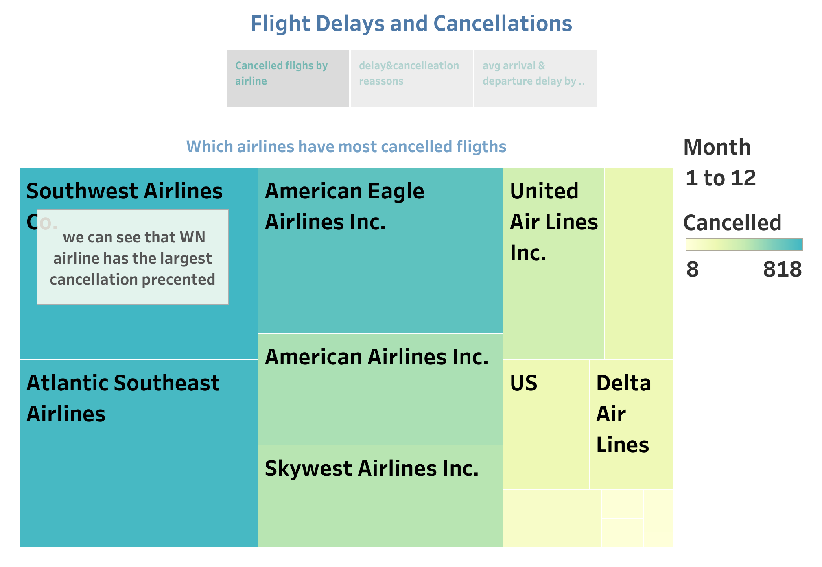

Slide 3
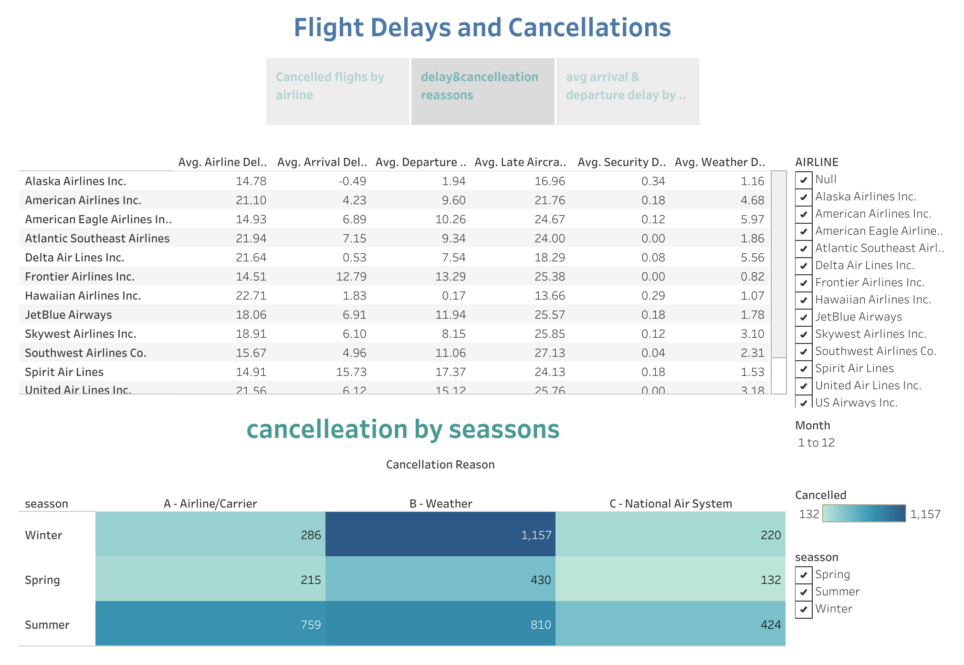

Slide 4
